Slide 1
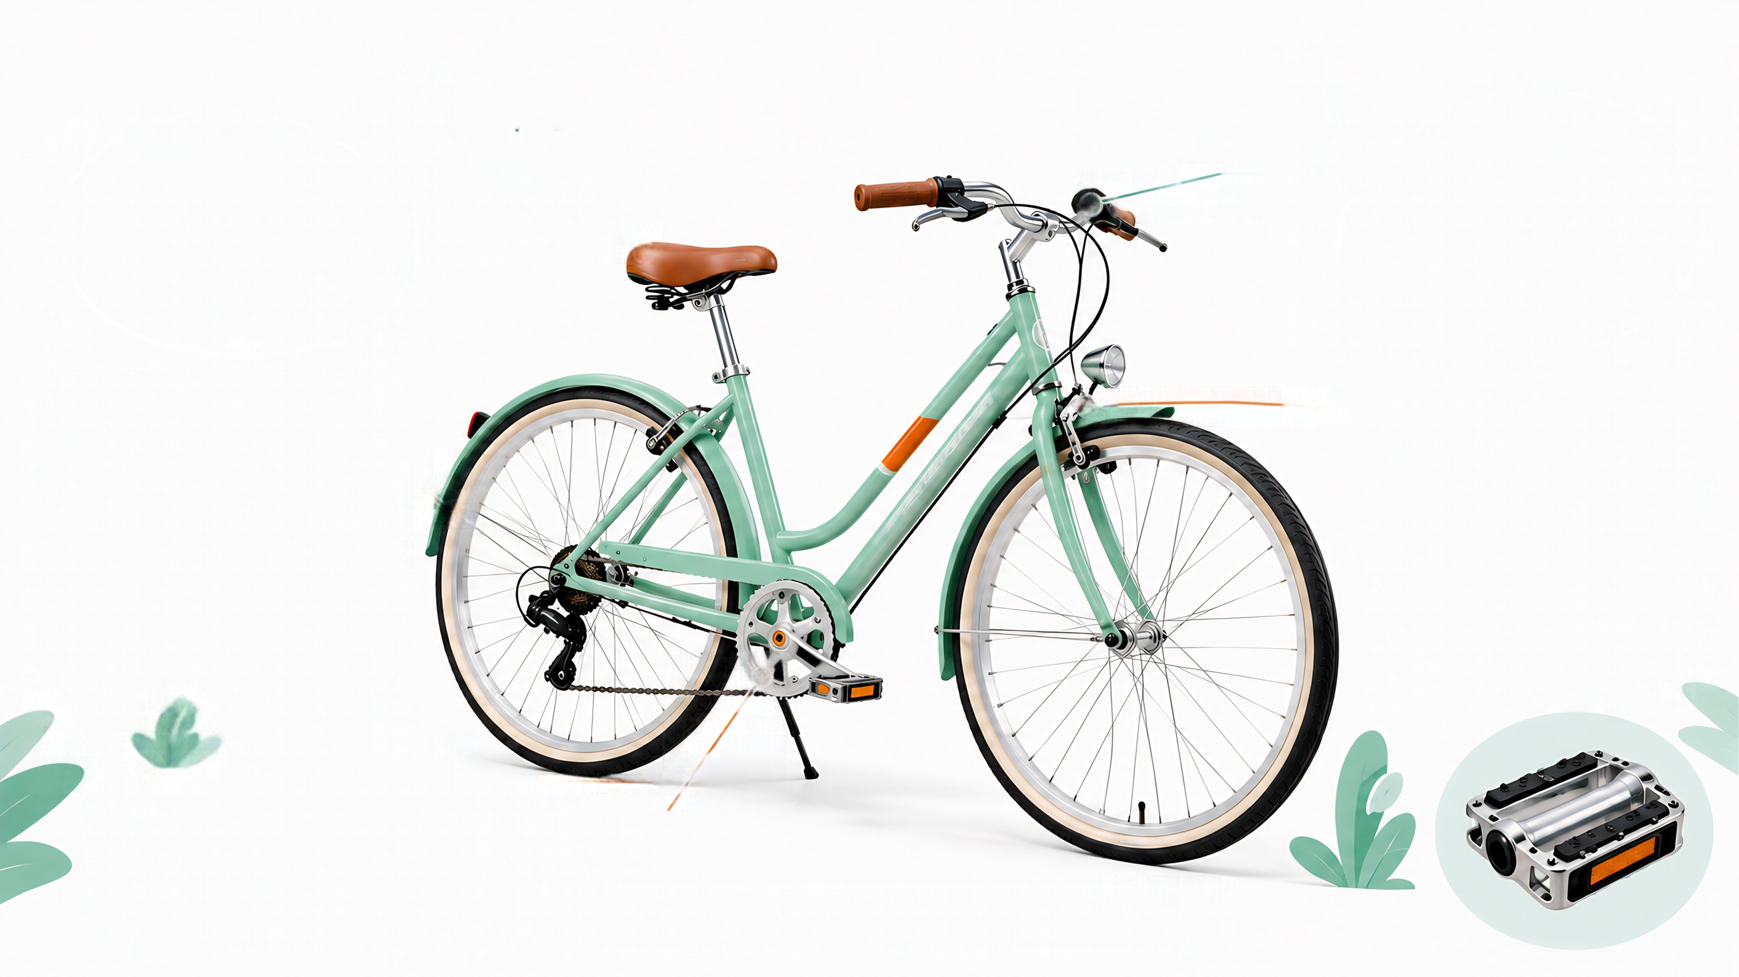






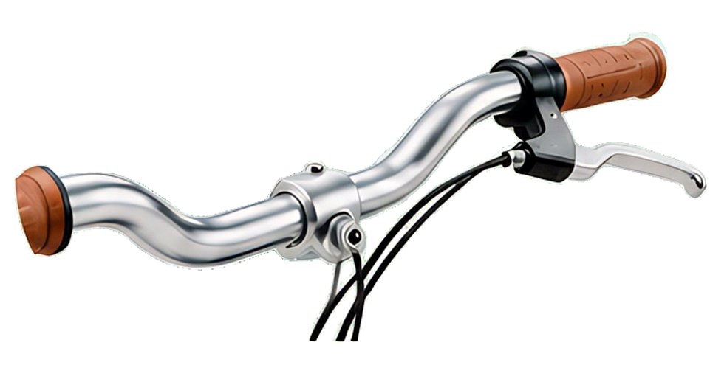

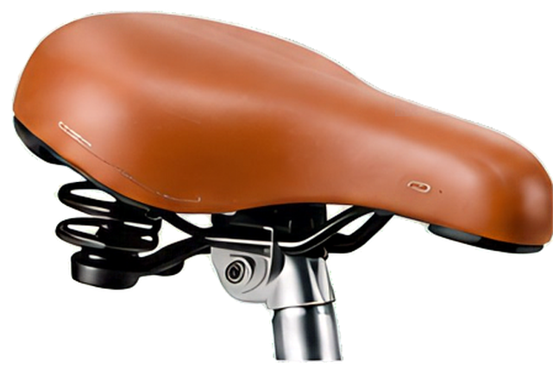
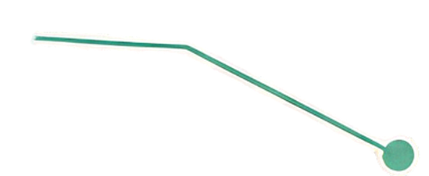
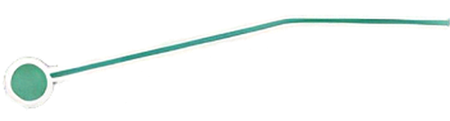




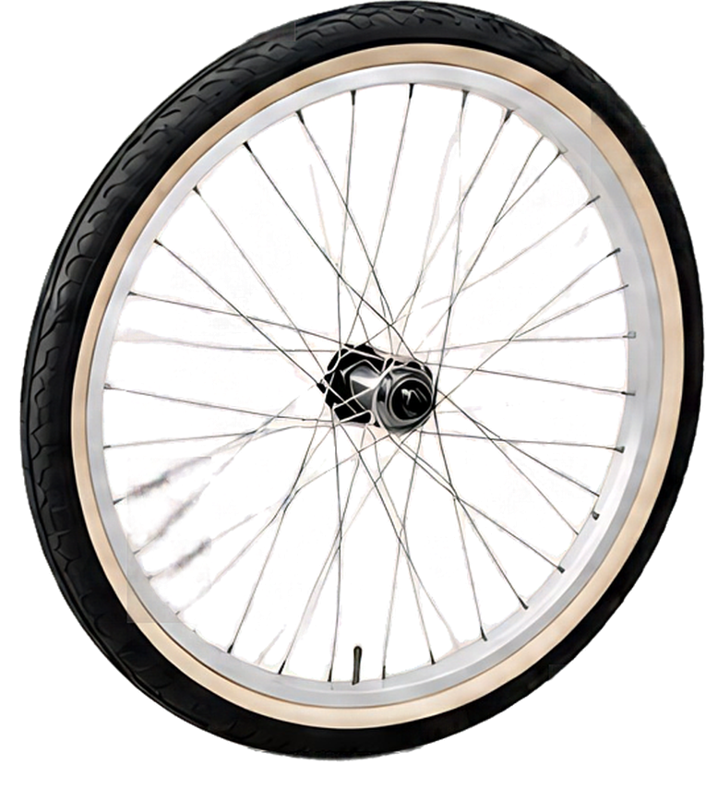
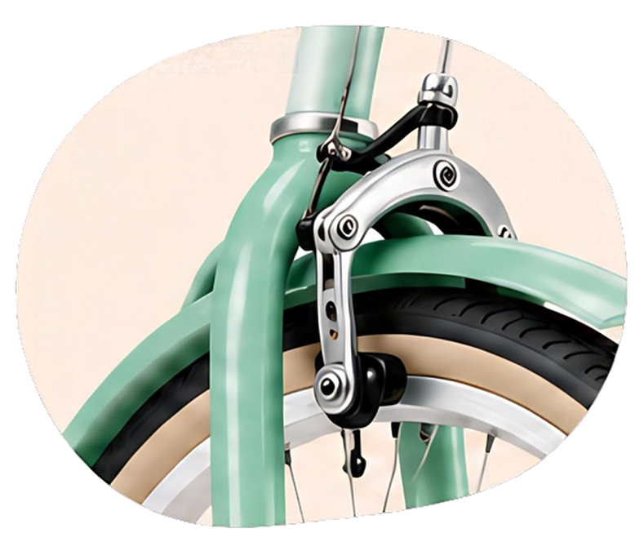
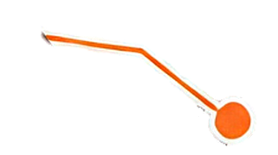




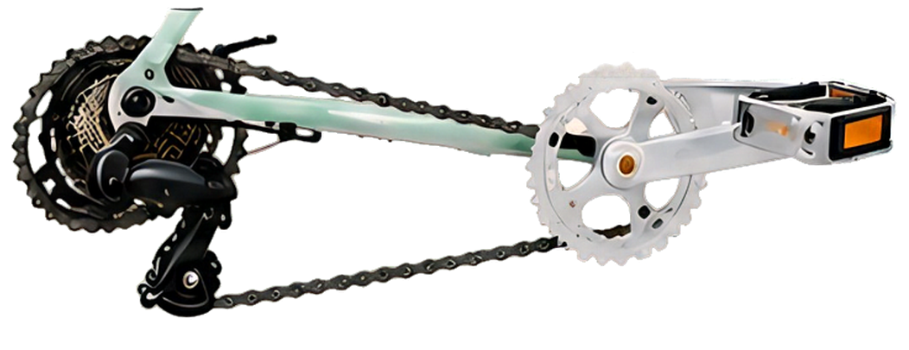




认识一辆自行车
车座
车把
车轮
刹车
传动
各个部件协同配合，让骑行更顺畅
Notes:
Reuses the 30 original image objects from slide 9 of the 2026-10-28 Full-element conversion. Text has been set for this Chinese/English editing exercise; English and bilingual labels have wider image backplates. The original artwork was AI-generated.
https://2pptx.com/zh/blog/translate-image-based-powerpoint-slides

Slide 2
Bicycle parts
Saddle
Handlebar
Wheel
Brake
Drivetrain
Parts work together for a smooth ride
Notes:
Reuses the 30 original image objects from slide 9 of the 2026-10-28 Full-element conversion. Text has been set for this Chinese/English editing exercise; English and bilingual labels have wider image backplates. The original artwork was AI-generated.
https://2pptx.com/zh/blog/translate-image-based-powerpoint-slides

Slide 3
认识一辆自行车
Bicycle parts
车座
车把
Saddle
Handlebar
车轮
Wheel
刹车
Brake
传动
Drivetrain
部件协同配合 / Parts working together
Notes:
Reuses the 30 original image objects from slide 9 of the 2026-10-28 Full-element conversion. Text has been set for this Chinese/English editing exercise; English and bilingual labels have wider image backplates. The original artwork was AI-generated.
https://2pptx.com/zh/blog/translate-image-based-powerpoint-slides

